Slide 1
STRATEGIC MARKETING
Digital and Social Media Marketing
Prof. Mohammed Rafiq
Professor of Marketing
Notes:
Hello and Welcome to todays lecture on Digital and Social Media Marketing.

Slide 2
Online, Social Media and Mobile Marketing
Topic outline
Digital and social media marketing
Marketing, the Internet and the digital age
Online marketing
The new direct marketing model
Rapid growth of direct and digital marketing
Benefits of direct and digital marketing to buyers and sellers.
Notes:
In the previous lecture we discussed how to engage customers and communicate marketing value through integrated marketing communications (IMC) and the four elements of the communications mix namely, advertising, public relations (publicity), personal selling and sales promotions. In this lecture we examine digital marketing (that is online, social media and mobile marketing).
Spurred on by a surge in internet usage as well as rapid advances in digital technologies ranging from smartphones and tablets to the spate of social media platforms–(direct) digital marketing has undergone a dramatic transformation – it has become a blend of communications and distribution channels all rolled into one.

Slide 3
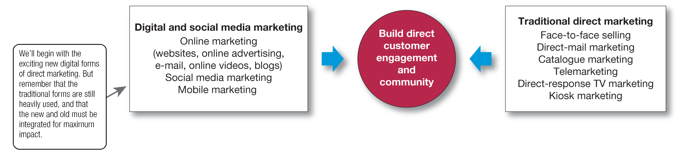
Forms of direct and digital marketing
Notes:
Figure 17.1 Forms of direct and digital marketing
The major forms of direct marketing—as shown in this slide —are digital and social media marketing, and traditional direct marketing.
Traditional direct marketing tools, as we discussed previously, include face-to-face selling, direct-mail marketing, catalog marketing, telemarketing, direct-response television marketing, and kiosk marketing.
In recent years, however, a dazzling new set of digital direct marketing tools has burst onto the marketing scene, including online marketing (Web sites, online ads and promotions, e-mail, online videos, and blogs), social media marketing, and mobile marketing and have taken over much of traditional marketing activities.

Slide 4
Digital and social media marketing
Digital and social media marketing - Using digital marketing tools such as websites, social media, mobile apps and ads, online video, e-mail and blogs that engage consumers anywhere, anytime via their digital devices.
Notes:
So what is digital marketing?
Digital and social media marketing – is the use of digital marketing tools such as websites, social media, mobile apps and ads, online video, e-mail and blogs that engage consumers anywhere, anytime via their digital devices

Slide 5
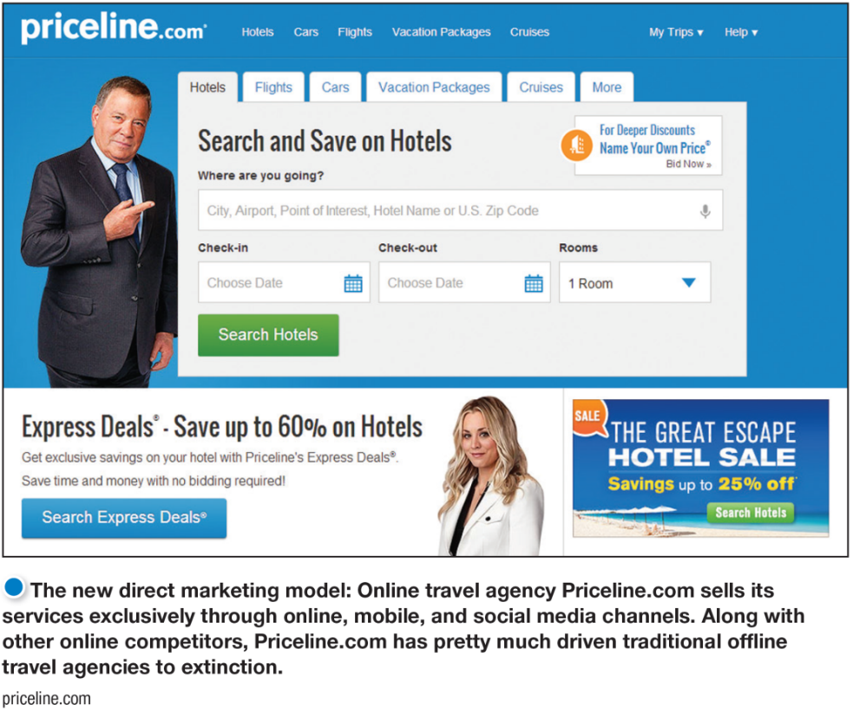
Direct and Digital Marketing
The New Direct Marketing Model
For many companies today, direct and digital marketing constitute a complete model for doing business.
Notes:
The emergence of digital marketing has led to a new direct marketing model: For instance, the US based Online travel agency Priceline.co, illustrated here, sells its services exclusively through online, mobile, and social media channels. Along with other online competitors, Priceline.com has pretty much driven traditional offline travel agencies into extinction.
Most companies still use direct marketing as a supplementary channel or medium, but for many companies today, direct and digital marketing are more than just supplementary channels or advertising media— they constitute a complete model for doing business. Firms employing this direct model use it as the only approach. Companies such as Facebook, Amazon, Google, eBay, Netflix, and Priceline.com have successfully built their entire approach to the marketplace around direct and digital marketing.
Spurred by the surge in Internet usage and buying, and by rapid advances in digital technologies direct marketing has undergone a dramatic transformation. In previous chapters we have discussed direct marketing as direct distribution—as marketing channels that contain no intermediaries. We also included direct and digital marketing elements of the promotion mix—as an approach for engaging consumers directly and creating brand community. In actuality, direct marketing is both of these things and much more.

Slide 6
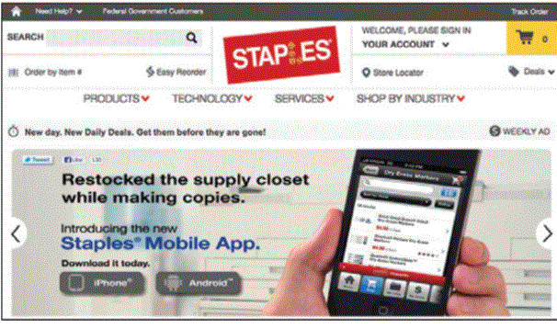
Digital and Social Media Marketing
Marketing, the Internet, and the Digital Age
Multichannel marketing involves marketing both through stores and other traditional offline channels and through digital, online, social media, and mobile channels.
Copyright © 2016 Pearson Education, Inc.
17-16
Notes:
Multichannel marketing: More than 43 percent of Staples’ sales come from its online marketing operations, including its Web site and mobile app, its presence on social media, and its own Staples.com community.
The digital age has fundamentally changed customers’ notions of convenience, speed, price, product information, service, and brand interactions. As a result, it has given marketers a whole new way to create customer value, engage customers, and build customer relationships.
More than half of all U.S. households now regularly shop online, and digital buying continues to grow at a healthy double-digit rate. It’s estimated that nearly half of all U.S. retail sales were either transacted directly online or influenced by Internet research. In the UK, over 30 % of all retail sales are now online and growing rapidly as result of restriction s resulting from Covid-19.
To reach this burgeoning market, most companies now market online. Some companies operate only online. Today, however, it’s hard to find a company that doesn’t have a substantial online presence.
Even companies that have traditionally operated offline have now created their own online sales, marketing, and brand community channels. In fact, multichannel marketing companies are having more online success than their online-only competitors.
In fact, Multichannel marketing has now given way to omnichannel marketing where offline and online communications and sales are closely integrated so that consumers can shop seamlessly through any channel.

Slide 7
Digital and Social Media Marketing
Online Marketing
Online marketing is marketing via the Internet using company Web sites, online ads and promotions, e-mail, online video, and blogs.
Marketing Web sites engage consumers to move them closer to a direct purchase or other marketing outcome.
Branded community Web sites present brand content that engages consumers and creates customer community around a brand.
Copyright © 2016 Pearson Education, Inc.
17-17
Notes:
Digital and social media now takes on many forms – we discuss the some of the major ones now
Online marketing refers to marketing via the Internet using company Web sites, online advertising and promotions, e-mail marketing, online video, and blogs. Social media and mobile marketing also take place online and must be closely coordinated with other forms of digital marketing. However, because of their special characteristics, we discuss the fast growing social media and mobile marketing approaches in separate sections.
For most companies, the first step in conducting online marketing is to create a Web site. Web sites vary greatly in purpose and content. Some Web sites are primarily marketing Web sites.
While branded community Web sites don’t try to sell anything at all, they promote the brand its values and attempt to engage customers and prospects.

Slide 8
Digital and Social Media Marketing
Online Marketing
Online advertising is advertising that appears while consumers are browsing online and includes display ads, search-related ads, online classifieds, and other forms.
E-mail marketing involves sending highly targeted, highly personalized, relationship-building marketing messages via e-mail.
Spam is unsolicited, unwanted commercial e-mail messages.
Copyright © 2016 Pearson Education, Inc.
17-18
Notes:
As consumers spend more and more time online, companies are shifting more of their marketing spend to online advertising to build brand sales or attract visitors to their Internet, mobile, and social media sites. Online advertising has become a major promotional medium. Together, display and search-related ads account for the largest portion of firms’ digital marketing budgets, capturing 30 percent of all digital marketing spending.
E-mail marketing remains an important and growing digital marketing tool. “Social media is the hot new thing,” says one observer, “but e-mail is still the king.” By one estimate, over 90 percent of consumers use e-mail every day. What’s more, e-mail is no longer limited to PCs and workstations; 65 percent of all e-mails are now opened on mobile devices. Not surprisingly, then, a recent study found that e-mail is more effective at capturing customers than Facebook and Twitter combined. Marketers sent an estimated more than 838 billion e-mails last year.

Slide 9
Digital and Social Media Marketing
Online Marketing
Viral marketing is the digital version of word-of-mouth marketing: videos, ads, and other marketing content that is so infectious that customers will seek it out or pass it along to friends.
Online video marketing involves posting digital video content on brand Web sites or social media sites such as YouTube, Facebook, and others.
Copyright © 2016 Pearson Education, Inc.
17-19
Notes:
Because customers find and pass along the message or promotion, viral marketing can be very inexpensive. And when video or other information comes from a friend, the recipient is much more likely to view or read it.
Some videos are made for the Web and social media. Such videos range from “how-to” instructional videos and public relations (PR) pieces to brand promotions and brand-related entertainment. Other videos are ads that a company makes primarily for TV and other media but posts o
online before or after an advertising campaign to extend their reach and impact.

Slide 10
Digital and Social Media Marketing
Online Marketing
Blogs are online journals where people and companies post their thoughts and other content, usually related to narrowly defined topics.
Social media are independent and commercial online communities where people congregate, socialize, and exchange views and information.
Copyright © 2016 Pearson Education, Inc.
17-20
Notes:
Brands also conduct online marketing through various digital forums that appeal to specific special-interest groups.
Blogs can be about anything, from politics or baseball to haiku, car repair, brands, or the latest television series. According to one study, there are now more than 31 million blogs in the United States. Many bloggers use social networks such as Twitter, Facebook, and Instagram to promote their blogs, giving them huge reach. Such numbers can give blogs—especially those with large and devoted followings—substantial influence.

Slide 11
Digital and social media marketing
Social media marketing
Using social media
Social media marketing advantages and challenges
Integrated social media marketing.
Notes:
Now, let’s look at Social Media Marketing in a little more detail
There exists a dazzling array of online social media and digital communities. Countless independent and commercial social networks have arisen that give consumers online places to congregate, socialize, and exchange views and information. Wherever consumers congregate, marketers will surely follow. In fact, the vast majority of companies now use social media networks as part of their marketing mixes.
Using Social Media
Marketers can use existing social media or they can set up their own. Using existing social media seems the easiest. Thus, most brands have set up shop on a host of social media sites with links to each brand’s Facebook, Google, Twitter, YouTube, Flickr, Instagram, Tik-Tok, or other social media pages.
Social Media Marketing Advantages and Challenges
Using social media presents both advantages and challenges.
Targeted and personal
Interactive
Immediate and timely
Real-time marketing
Cost effective
Engagement and social sharing capabilities
Because consumers have so much control over social media content, even the seemingly most harmless social media campaign can backfire.
million.” With social media, “you’re going into the consumer’s backyard. This is their place,” warns one social marketer. “Social media is a pressure cooker,” says another. “The hundreds of thousands, or millions, of people out there are going to take your idea, and they’re going to try to shred it or tear apart and find what’s weak or stupid in it.”
Integrated Social Media Marketing
Most large companies are now designing full-scale social media efforts that blend with and support other elements of a brand’s marketing strategy and tactics. Using social media successfully involves integrating a broad range of diverse media to create brand-related social sharing, engagement, and customer community.

Slide 12
Social Media and Mobile Marketing
Social Media Marketing
Advantages:
Targeted and personal
Interactive
Immediate and timely
Real-time marketing
Cost effective
Engagement and social sharing capabilities
Notes:
Using social media presents advantages and challenges.
The advantages of social media include:
The ability to target individuals and personalize the product and promotions
Its Interactivity gives the seller and the customer the ability to interact with each other in an immediate and timely manner
It enables Real-time marketing –which means that aspects of marketing strategy can be changed immediately , For example pricing and promotions can be tailored to suit the profile of a customer.
It is Cost effective – social media much cheaper than conventional media such as TV
It also provides Engagement and social sharing capabilities -that is, it has the ability to engage customers and the sharing capabilities facilitates the spread of word of mouth communications and enables viral marketing
The downside of using social media is that
Because consumers have so much control over social media content, even the seemingly most harmless social media campaign can backfire. With social media, “you’re going into the consumer’s backyard. This is their place,” warns one social marketer. “Social media is a pressure cooker,” says another. “The hundreds of thousands, or millions, of people out there are going to take your idea, and they’re going to try to shred it or tear it apart and find what’s weak or stupid in it.”

Slide 13
Social Media Marketing
Marketers no longer are the only ones who talk about their products.
Millions of consumers have the ability and desire to spread good (or bad) news about products.
The many-to-many communication model is based on consumers talking to one another about goods, services, and organizations.
.
Notes:
LECTURE NOTES:
The Web Revolution is here! What has led to this new communication model, and how is it altering the face of marketing? Much of the answer lies in changing technology.
Everyone is online now. Millions of people around the globe surf the web, talk with their friends, watch TV, and purchase products from traditional marketers, from Internet-only marketers, and from each other on their computers, smartphones, or tablets. For example,, Facebook now has 2.7 billion active users, more than the population of any country.
All these users have the potential to connect with each other and to share feedback—. That’s why we’re moving from a one-to-many communication model to the new world of many to many.
In other words, today’s consumers increasingly get their information on and about products running shoes, nightclubs, cars, new bands, from one another rather than from the original source.

Slide 14
Product Review Sites
Product review sites: Social media sites that enable people to post stories about their experiences with goods and services.
Popular review sites include TripAdvisor, Yelp, and Angie’s List
Notes:
LECTURE NOTES:
A good example of consumers sharing information is provided by product review sites
Product review sites are social media sites that enable people to post stories about their experiences with products and services.
Marketers hope that product review sites create a connection between the consumer and the brand.
Product review sites give users both positive and negative information about companies
Product reviews have become such important review tools for potential customers that some companies have been accused of actively manipulating reviews to benefit themselves.
How reliable are product reviews

Slide 15
Social Networks
Social networks, like Facebook and Twitter, are sites that connect people with other people.
Marketers monitor social networks to learn what consumers are thinking about the brand and the competition..
Marketers reach influential opinion leaders by participating in social media conversations.
Social networks provide an opportunity to create a brand community.
Notes:
LECTURE NOTES:
The best examples of people connecting with each other are social networks such as Facebook, Twitter, Instagram etc
Successful networking sites ask users to develop profiles of themselves so that those with similar backgrounds, interests, hobbies, religious beliefs, racial identities, or political views can “meet” online. Social networks such as Facebook and LinkedIn are some of the most popular sites on the Internet with millions of users from around the globe. The profiles can be used to accurately target potential customers with marketing communications and products.
In addition
By monitoring social networks, marketers learn what consumers are thinking and what they are saying to each other about their brand and about the competition. Such information can be invaluable to improve advertising messages or even to correct defects in products.
By participating in the conversations, marketers can reach influential people such as journalists and consumers who are opinion leaders.
Most importantly, social networks provide firms the opportunity to create a brand community, a group of social network users who share an attachment to a product or brand. Members of the brand community interact with each other, sharing information about the brand or just expressing their affection for it. As a result, the relationships between the consumers and the brand grow even stronger.

Slide 16
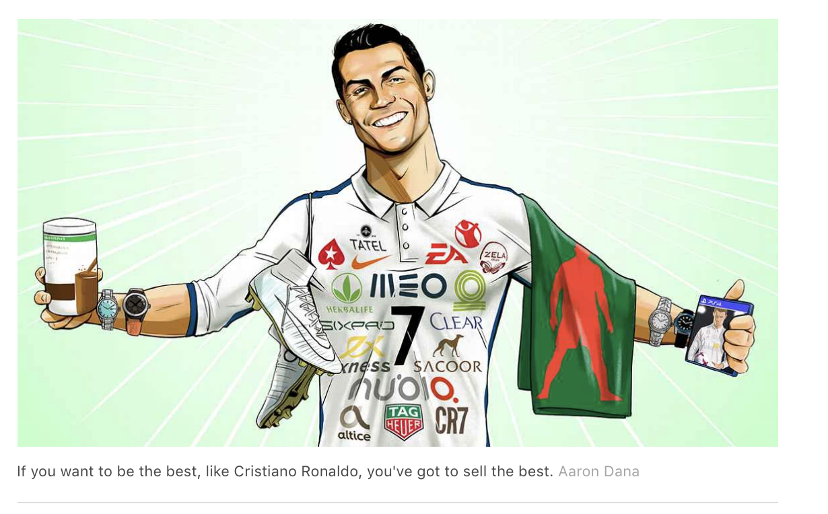
Influencer Marketing: the world of Cristiano Ronaldo
Notes:
LECTURE NOTE:
A key technique in social media marketing is the use of Influencers
Influencers are famous people who will promote a brand using social media, so that their followers will be interested in the brand and be guided by the influencer to make a purchase, and they can be paid a fortune for doing so. It has made social media lucrative territory for people with large online followings.
Christiano Ronaldo has 406.6 million followers on social media platforms. For each Instagram post, he makes $975,000 USD.

Slide 17
Why is Influencer Marketing Important?
Hiring such influencers allows companies to reach a vast network of potential customers: Cristiano Ronaldo has a combined following of 240m people across Facebook, Instagram and Twitter.
Social media offer brands their best opportunity to reach cord-cutting millennials: Snapchat, the picture-sharing app, reaches 40% of all American 18- to 34-year-olds every day.
Consumers feel they have gained unprecedented access to the lives of the rich and famous.
Sponsors interact with their target audiences in ways that traditional advertising cannot match. In turn, demand from marketers for these channels has made social media lucrative territory for people with large online followings.
Notes:
LECTURE NOTE:
Hiring influencers allows companies to reach a vast network of potential customers: Cristiano Ronaldo has a combined following of 240m people across Facebook, Instagram and Twitter.
Social media offer brands their best opportunity to reach millennials – the most active social media users For instance, Snapchat, the photo-sharing app, reaches 40% of all 18- to 34-year-olds every day.
Consumers feel they have gained unprecedented access to the lives of the rich and famous.
Sponsors interact with their target audiences in ways that traditional advertising cannot match. In turn, demand from marketers for these channels has made social media lucrative territory for people with large online followings.

Slide 18
Planning an Influencer Campaign
Confirm
Confirm your objectives, target channels and align some measurable KPIs
Define
Define your target influencers
Define
Define your budget
Build
Build an influencer list and do your research
Base
Base your pitch on the individual and clearly list the essentials
Notes:
Planning an Influencer Campaign.
As with other marketing tools, using influencers as part of a social media strategy requires a systematic planned approach which includes defining objectives for the promotional campaign, define what approach to be used with the influencer, allocating an appropriate budget, choosing a specific influencer and working with the influencer to achieve your objectives.
Defining your goals in the early stages of planning will help you shape a consistent strategy throughout your campaign, and it will also give you an idea about the metrics you should track and monitor to measure your success at the end of the campaign.
Some goals you may want to consider for your influencer marketing strategy include :
Brand awareness: Building brand identity and Audience building to Getting more people to follow and subscribe.
Once you know your goals, it’s time to start thinking about the type of influencer marketing campaign that will help you accomplish your mission. Influencer marketing campaigns usually involve three types of relationship triggers:
One, inspire an influencer to share your content or messaging on their own
Or to, hire or pay them to promote your brand
or a mix of both.
Build an Influencer list
With your audience clearly defined, you can finally start seeking out the influencers who will help you reach your goals and connect with your target market. Which could include bloggers, social media stars, celebrities, industry experts, thought leaders, or customers.
Once you have determined the type of influencer you want to use, start researching individuals or brands in that space.
Base your pitch on the individual influencer and Use your influencer as a way of personalising the social media message to create engagement amongst the intended audience.

Slide 19
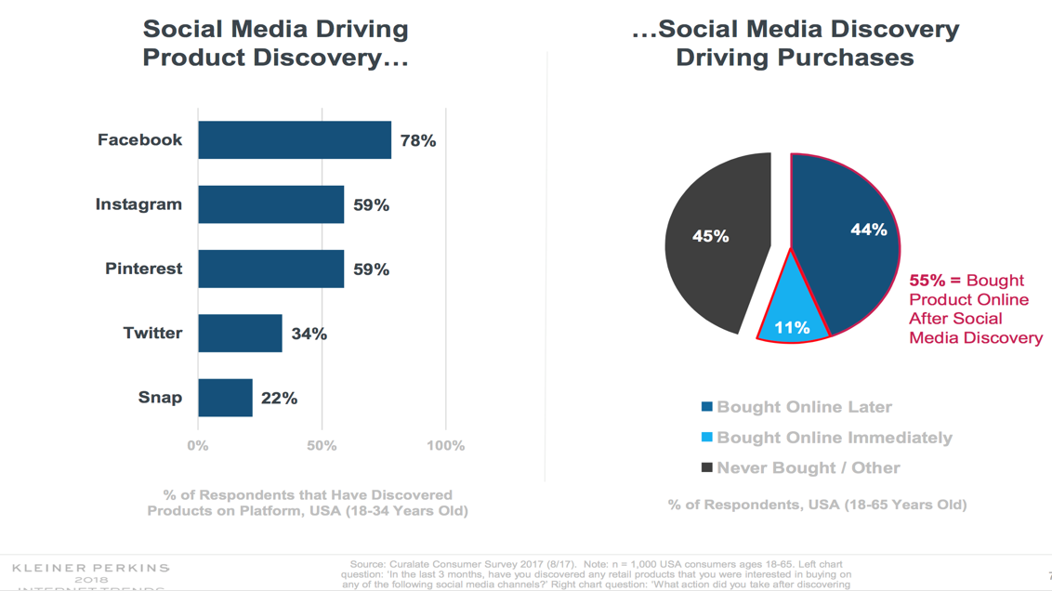
Effectiveness of Social Media Marketing
Notes:
This slide summarises the effectiveness of using social media .It shows the percentage of respondents in a survey of US consumers in 2017 that had discovered products via social media a platform and bought products after discovering products on social media.
The figures range from 22% for Snapchat to 78% for Facebook respondents between the ages of 18 and 34 years who discovered products on the platform
The slide also shows that 55 of respondents between 18-65 years bought a product after discovering it on Social Media. With 11% buying immediately.
These figures demonstrate the increasing dominance of social media in reaching potential customers and getting them to purchase products.

Slide 20
Integrated Omnichannel Campaigns
Digital and social media campaigns are most effective when they are integrated with other marketing channels
Digital and Social media not just channels of communication but also a channel of distribution
Key issue is consistency of messages across all touchpoints – online and offline.

